Slide 1
Cardiometabolic health in HIV
22 November 2023
Faculty
Pedro Cahn, Buenos-Aires, Argentina
Anton Pozniak, London, UK
François Raffi, Nantes, France

Slide 2
Cardiovascular and metabolic disease in HIV
What are the specificities in HIV population ?
Increased inflammation in chronic HIV infection
Increased weight gain under cART
High frequency of metabolic syndrome which is associated with diabetes mellitus, arterial hypertension and metabolic dysfunction-associated liver steatosis
Increased inflammation and atherosclerosis both increase risk for major cardiovascular events
Objectives
Understand Pathophysiology
Rationale for Management and Prevention

Slide 3
HIV infection
HIV
Immune Activation
Inflammation
Immune deficit
X
Cardiovascular risk
Osteoporosis
Cognitive deficit
Cancers
Potent cART
AIDS
(OI, cancers)
Aging
With advances in ART and almost universal virologic suppression and immune restoration, most diseases and deaths in people with HIV are now attributable to noncommunicable illnesses, especially cardiovascular diseases

Slide 4
Pooled risk ratio for risk of cardiovascular disease in people living with HIV in comparison with those without (meta-analysis)
Author(s)
Years
Weights
Risk Ratio [95% Cl]
Cardiovascular events
Gardner et al
Aldaz et al
Helleberg et al
Tripathi et al
Womack et al
RE Model (Q = 60.48, df = 4;I² = 89.2% [95% CI 71.6 - 99.2])
2003
2011
2012
2014
2014
3.0
4.3
6.9
7.2
5.7
6.40 [2.13 , 19.25]
3.10 [1.30 , 6.10]
2.50 [2.00 , 3.10]
1.15 [1.04 , 1.27]
2.80 [1.70 , 4.60]
2.36 [1.50 ,3.70]
Myocardial infarction
Triant et al
Durand et al
Klein et al
Althoff et al
Rasmussen et al.1
RE Model (Q = 15.06, df = 4;I² = 64.6% [95% CI 19.9 - 95.7])
2009
2011
2015
2015
2015
5.9
6.9
7.2
7.1
7.1
1.93 [1.21 , 2.93]
2.11 [1.69 , 2.63]
1.40 [1.20 , 1.60]
1.76 [1.49 , 2.07]
2.02 [1.71 , 2.38]
1.79 [1.54 , 2.08 ]
Stroke
Qureshi et al
Cole et al
Chow et al
Mateen et al
Walker et al
Rasmussen et al.2
Sico et al
RE Model (Q = 62.56, df = 6;I² = 97.0% [95% CI 92.8 - 99.5])
RE Model Studies (Q = 156.91, df = 16;I² = 94.9% [95% CI 91.4 - 98.7])
1997
2004
2012
2013
2013
2015
2015
3.2
4.1
7.0
6.0
4.0
7.2
7.1
3.20 [1.10 , 8.90]
13.70 [6.10 , 30.80]
1.21 [1.01 , 1.46]
2.16 [1.39 , 3.31]
5.61 [2.41 , 13.09]
1.84 [1.60 , 2.13]
1.17 [1.01 , 1.36]
2.56 [1.43 , 4.61 ]
2.16 [1.68 , 2.77]
0.75
1
2
4
8
12
16
20
Risk Ratio
Sha ASV. Circulation 2018; 138:1100-12

Slide 5
HIV infection is an independent CV risk factor
Traditional risk factors are associated with increased CVD risk in HIV
Risk predictors developed in non-HIV populations poorly predict CV risk in HIV
Underestimation of CV risk
HIV-specific calculators have been proposed (biomarkers, ART), but none validated with current ART and HIV immuno-virological control
HIV associated with increased preclinical atherosclerosis (carotid intima-media thickness): similar in magnitude to that of diabetes and smoking [FRAM study]
Acute myocardial infarction: 50% increased risk with, similar to diabetes mellitus [Veterans Cohort]
D’Agostino RB. JID 2012, Friis Moller N. Europ J Prev Cardiol 2015, Feinstein MJ. JAMA Cardiol 2017, Triant V. Circulation 2018; Grunfeld C. AIDS 2009; 23:1841-9;
Freiberg MS. JAMA Intern Med 2013; 173:614-22

Slide 6
Subclinical coronary artery disease in HIV
Comparison of frequency of subclinical coronary artery disease using coronary CT angiography in individuals > 40 years with no known CAD
PLWH, N=519 (99% on ARV, HIV RNA < 50 c/ml : 96%, CD4 ≥ 350/mm³ : 92%)
Sex and age-matched non-HIV infected individuals (Copenhagen general population), N=1 114
% with coronary artery disease
Association between HIV and coronary artery disease
60
54%
Uninfected individual
Fully adjusted
Adjusted for smoking
Unadjusted
PLHIV
Fully adjusted odds ratio
42%
Any CAD
1.78 (1.40-2.28) ; p < 0.001
40
32%
Obstructive vs no CAD
3.21 (2.00-5.17) ; p < 0.001
Non-calcified
plaques
2.91 (2.06-4.11) ; p < 0.001
20
16%
15%
8%
Napkin Ring Sign
2.39 (1.19-4.80) ; p = 0.014
5%
1,5%
0
Any CAD
Obstructive
CAD (≥50%
stenosis)
Non-calcified
plaques
Napkin
Ring Skin
1.0
1.4
2.0
6.0
Odds ratio
Conclusion: 3-fold higher odds of obstructive CAD in HIV+
EACS 2023 - Knudsen AD, PS4.03

Slide 7
Coronary Artery Disease in Persons With HIV Without Detectable Viral Replication
Risk Factors and Adjusted Odds of Coronary Atherosclerosis or Obstructive CAD (n = 669)
 | Any Coronary Atherosclerosis |  | Obstructive CAD
 | aOR (95%CI)* | p | aOR (95% CI) * | p
Age, per decade older | 3,38 (2,64 – 4,33) | <0.001 | 2.85 (2.19 – 3.73) | <0.001
Male sex | 2,70 (1,64 – 5,42) | 0.005 | 1.20 (0.49 – 2.92) | ns
Hypertension | 1.57 (1.05 – 2.37) | 0.03 | 1.66 (1.01 – 2.75) | 0.046
Diabetes | 2.87 (0.80 – 10.38) | ns | 2.90 (1.02 – 8.24) | 0.045
Current smoker | 1.71 (1.05 – 3.13) | 0.04 | 2.30 (1.24 -4.26) | 0.008
Dyslipidemia | 1.81 (1.05 – 3.13) | 0.03 | 2.01 (1.11 – 3.67) | 0.02
BMI > 30 kg/m² | 3.37 (1.43 – 7.93) | 0.005 | 1.26 (0.48 – 3.32) | ns
Current CD4 < 500/mm3 | 0.58 (0.35 – 0.97 | 0.04 | 0.93 (0.52 – 1.64) | ns
Nadir CD4 < 200 | 1.04 (0.68 – 1.58) | ns | 1.53 (0.94 – 2.47) | ns
CD4/CD8 ratio | 1.03 (0.67 – 1.58) | ns | 1.27 (0.82 – 1.99) | ns
Time since HIV diagnosis (per 5 years) | 1.16 (1.02 – 1.31) | 0.02 | 1.34 (1.16 – 1.55) | < .001
Current protease inhibitor use | 1.49 (0.96 – 2.31) | ns | 1.73 (1.06 – 2.84) | 0.03
Current INSTI use | 0.71 (0.46 – 1.10) | ns | 0.94 (0.90 – 2.69) | ns
High levle of IL-6 | 1.02 (0.61 – 1.50) | ns | 1.56 (0.90 – 2.69) | ns
hsCRP > 2 mg/L | 1.11 (0.66 – 1.86) | ns | 1.11 (0.66 – 1.86) | ns
Copenhagen Comorbidity in HIV Infection (COCOMO) study : 669 HIV+ (mean age 51 years, 89% male) : 45% had atherosclerosis and 18% obstructive CAD on coronary CT angiography
* Adjusted ORs for the associations between risk factors and any atherosclerosis (defined as ≥1% coronary artery stenosis) or obstructive CAD (defined as ≥50% coronary artery stenosis).
Adjustments were based on a prespecified model and included age, sex, hypertension, diabetes, and smoking status
Knudsen AD. Open Forum ID 2023 May 31;10(7):ofad298

Slide 8
Do INSTI increase the risk of CVD ?

Slide 9
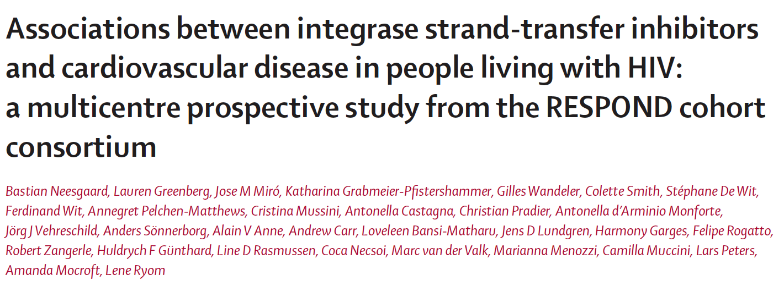
Incidence rate (IC 95%) per 1000-years of follow-up
12
10
8
6
29 340 PWH (74% male, 44 years), not exposed to INSTI before Jan 1, 2012.
Follow-up for major CVD events until Dec 31, 2019. During median follow-up of 6.2 years
- 47.7% exposed to INSTI
- 2.5% had a CVD event
4
2
0
0 month
>0 to 6 months
>6 to 12 months
>12 to 24 months
>24 to 36 months
>36 months
Number at risk
Person-years of follow-up Events (n)
Incidence rate ratio (95% CI)
29 340 120 714
506
4.49 (3.83-4.57)
13 602
8 154
69
8.46 (6.58-10.71)
12 103
6 489
34
5.24 (3.63-7.32)
10 804
10 327
69
6.68 (5.20-8.46)
8 376
7 287
31
4.25 (2.89-6.04)
>5 733
7 938
39
4.91 (3.49-6.72)
4.00
Adjusted incidence ratio
Many limitations :
- combination of data from multiple cohorts (n = 17) with heterogeneous data collection, absence of monitoring or quality control
- Selection bias, immortal time bias (time zero not defined)
- INSTI users could be ART-naive or experienced, virologically controlled or not : potential confounders might vary in these 3 situations, yet only a single analysis performed
Increased rate of CD events
2.00
1.00
Decreased rate of CD events
0.50
0.25
0 month
1 (ref)
>0 to 6 months
1.85 (1.44-2.39)
>6 to 12 months
1.19 (0.84-1.68)
>12 to 24 months
1.46 (1.13-1.88)
>24 to 36 months
0.89 (0.62-1.29)
>36 months
0.96 (0.69-1.33)
Adjusted incidence rate ratio (95% CI)
Lancet HIV. 2022 Jul;9(7):e474-e485

Slide 10
RESPOND: selection bias
Calendar time-adjusted likelihood of starting an INSTI,
by D:A:D estimated 5-year CVD risk score category
Adjusted odds ratio (95% CI)
P value
All included individuals
<1 % (low risk)
1 (ref)
1% to <5% (moderate risk)
1,12 (1,08-1,17)
<0,001
5% to <10% (high risk)
1,30 (1,23-1,38)
-
>10% (very high risk)
1,34 (1,24-1,46)
-
Art-experienced individuals
<1 % (low risk)
1 (ref)
1% to <5% (moderate risk)
1,26 (1,20-1,33)
<0,001
5% to <10% (high risk)
1,51 (1,40-1,63)
-
>10% (very high risk)
1,51 (1,39-1,68)
-
0,5
1,0
2,0
Decreased likelihood of INSTI treatment
Increased likelihood of INSTI treatment
The likelihood of starting an INSTI increased linearly with increasing risk of cardiovascular disease
Were all confounders taken into account in adjustment?
ART experienced, with VL <200 copies per mL, had significantly more CV events (3.2%) than those with VL > 200 c/mL (1.9%)
More INSTI patients were pre-exposed to ABC or ddI (59% vs 41%): this confounder was not taken into account (enough power?)
Lancet HIV. 2022 Jul;9(7):e474-e485

Slide 11
RESPOND : selection bias + measure bias ?
No possible interpretation : selection bias ?
Adjusted incidence ratio
No possible interpretation : measure bias ?
4.00
Increased rate of CD events
Only 1st CVD event taken into account
For individuals with a CV event before baseline, only incident CV events of a different subtype after baseline were recorded (if prior MI, new MI during follow-up excluded)
If occurrence of a CV event, no recording of further events
Designated case report forms were used : under-reporting ?
2.00
1.00
Decreased rate of CD events
0.50
0.25
0 month
1 (ref)
>0 to 6 months
1.85 (1.44-2.39)
>6 to 12 months
1.19 (0.84-1.68)
>12 to 24 months
1.46 (1.13-1.88)
>24 to 36 months
0.89 (0.62-1.29)
>36 months
0.96 (0.69-1.33)
Adjusted incidence rate ratio (95% CI)
Lancet HIV. 2022 Jul;9(7):e474-e485

Slide 12
Retrospective cohort study.
MeIBMMarketScan databases for U.S. commercially insured and Medicaid covered adults : PLWH newly initiated on ART between January 1, 2008 and December 30, 2015.
Major adverse cardiac event was the primary outcome.
Calendar time-specific probability-weighted Cox proportional hazards models to estimate hazard ratios and 95% CI for the association between INSTI use and MACE. Propensity score weighting methods were used to account for potential confounding
HR (95% CI)
A. Unadjusted model
1,10 (0,80-1,52)
B. IPTW model
0,79 (0,64-0,96)
C. IPTW model plus ABC
0,74 (0,60-0,90)
0,5
1,0
1,5
Hazard ratio
Hazard ratio estimates of overall MACE events associated with INSTI-based regimens versus non—INSTI-based regimens using calendar time inverse probability of treatment-weighted models. IPTW, inverse probability of treatment weighted; PS, propensity score. A, Unadjusted model (B) IPTW model using calendar time-specific PS (primary analysis). C, IPTW model using calendar time-specific PS including addi-tional variable (abacavir) (sensitivity analysis)
In the sensitivity analysis, ABC was associated with a 2.6 fold increased risk of MACE (95% CI : 2.0 to 3.5)
J. Acquir Immune Defic Syndr 2020;84:396-399

Slide 13
Cumulative CVD incidence (%)
Emulated trial in the Swiss HIV cohort study participants who were ART-naïve after May 2008 (n = 5 362)
34.3% started INSTI-based ART
65.7% started non-INSTI based ART
Within 4.9 years : 116 CVD events
Unadjusted
Adjusted
0.10
INSTI
0.10
INSTI
Other
6.94%
Other
0.08
0.08
0.06
0.06
0.04
0.04
3.34%
2.64%
0.02
2.61%
0.02
0
0
0
1
2
3
4
5
6
7
8
0
1
2
3
4
5
6
7
8
Years since ART start
Years since ART start
Clinical Infectious Diseases 2023;77(5):729–37

Slide 14
Hazard ratios (95% CI) of INSTI on CVD event risk overall and by prespecified subgroups *
Overall
0.80 (0.46-1.39)
Women
0.32 (0.10-1.11)
Men
0.94 (0.52-1.71)
Age > 65 years
0.69 (0.19-2.46)
Age < 65 years
0.87 (0.50-1.50)
No ABC
0.79 (0.43-1.46)
With ABC
0.86 (0.26-2.85)
0.3
1.0
3.0
10.0
Less events with INSTI
More events with INSTI
Forces :
- Emulated trial in in well-defined clinical situation (naïve PWH )
- Very limited selection and immortal time bias (time zero = availability of INSTI)
Limitation :
- 82% started during 2012-2019, so 5% of RESPOND study participants ???
* adjusted for confounders and informative censoring
Clinical Infectious Diseases 2023;77(5):729–37

Slide 15
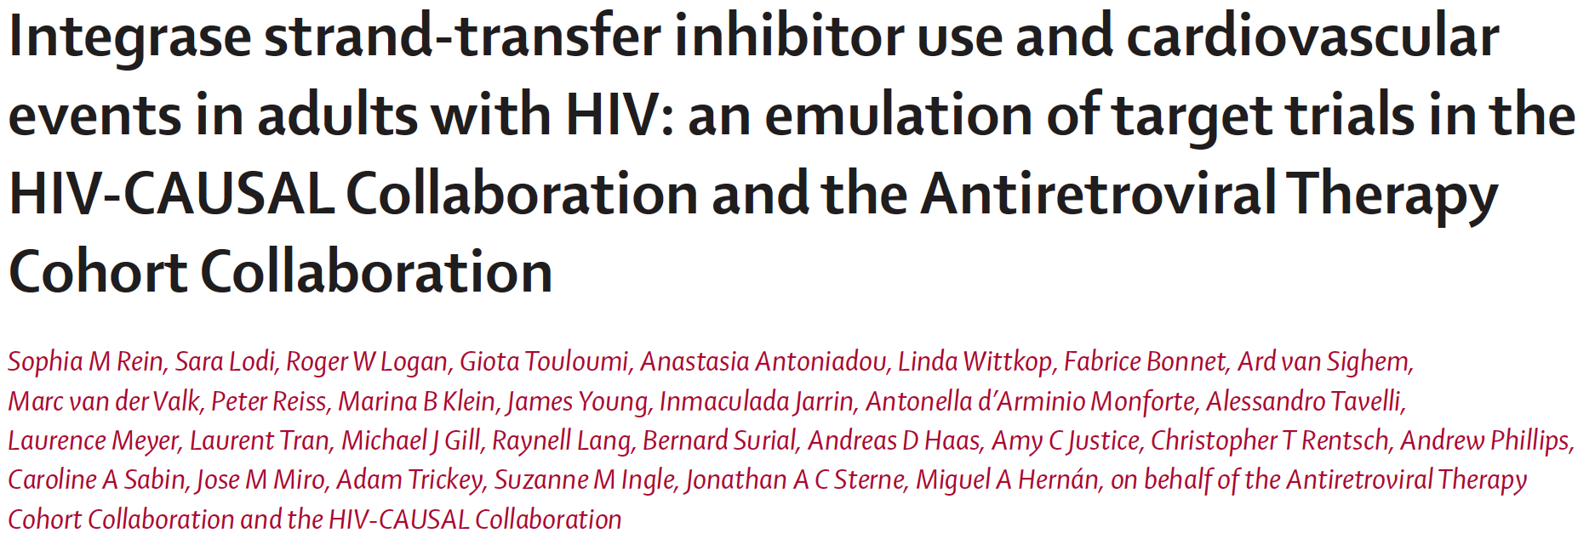
Cumulative incidence of major cardiovascular events (%)
Emulated trials (1 in ART-naïve patients, 1 in ART-experienced-patients) : 4-year risk of cardiovascular events
Clinical data from 12 cohorts of people with HIV from Europe and North America
Study period : 2013-2023
Caution : 3/12 cohorts already in RESPOND study (Athena, Icona, SHCS) = 45% of ART-naïve initiators of INSTI in this study !!!
ART-naive individuals
ART-experienced individuals
100
Initiating INSTI (10 767)
1.2
100
Initiating INST (7 875)I
No Initiating INSTI (8 292)
2.5
No Initiating INSTI (373 965)
0.96
2.0
0.72
1.5
0.48
1.0
0,24
0.
0
0
0
4
8
12
16
20
24
28
32
36
40
44
48
0
4
8
12
16
20
24
28
32
36
40
44
48
Months
Months
Lancet HIV 2023; 10:2723-32

Slide 16
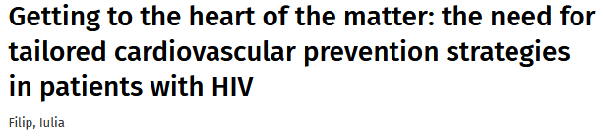
Increased incidence of CVD in HIV, related in part to increased atherosclerosis
Life expectancy in HIV patients with CVD and no other comorbidity 9 years shorter than non HIV patients, even if sustained virological suppression
CVD associated with
Traditional CV risk factors
Chronic inflammation, Immune dysregulation, metabolic toxicity of ART
HIV infection should be considered a specific and independent risk factor for CVD
AIDS: April 1, 2022 – Volume 36 – issue 5 – p N1-N3 doi: 10,1097/QAD.0000000000003181

Slide 17
Studies 1489 & 1490: B/F/TAF at 5 years (Pooled Analysis)
Fasting Lipids Through W240, mmol/dL, Median (Q1-Q3)
TC
LDL
HDL
TG
TC:HDL
4.6
4.1
Ratio, Median (IQR)
3.7
3.7
2.6
3.1
1.2
1.1
1.1
1.2
0
144
240
0
144
240
0
144
240
0
144
240
0
144
240
Week
Week
Participants, % | At Baseline | W48 | W48–96 | W96–144 | W144–192 | W192–240
Initiated lipid-lowering agents | 5 | 2 | 2 | 1 | 2 | < 1
Small increases in lipids, including HDL over 5 years, with stable TC:HDL ratios
Sax P, et al. AIDS 2022, Poster EPB150.

Slide 18
Impact of INSTI- and TAF-Related BMI Changes on Risk of Dyslipidemia
RESPOND Cohort: Data from 13/19 observational HIV cohorts
Adults on INSTI or bPI or NNRTI, with BL and follow-up BMI and ≥ 2 lipid and BP measures
Development of dyslipidemia (Total C > 240 or HDL < 35 or TG > 200 mg/dL or lipid-lowering therapy)
TAF but not INSTI was associated with incident dyslipidemia
Nonsignificant association after adjustment for time-updated BMI
Fully Adjusted Incidence Rate Ratios
 | IRR (95% CI)
Dyslipidemia INSTI with TAF INSTI, no TAF No INSTI with TAF | 1.21 (1.07, 1.37) 1.09 (0.99, 1.20) 1.15 (0.96, 1.17)
Byonanebye DM, et al. IAS 2023. Abstract OALBB0505.

Slide 19
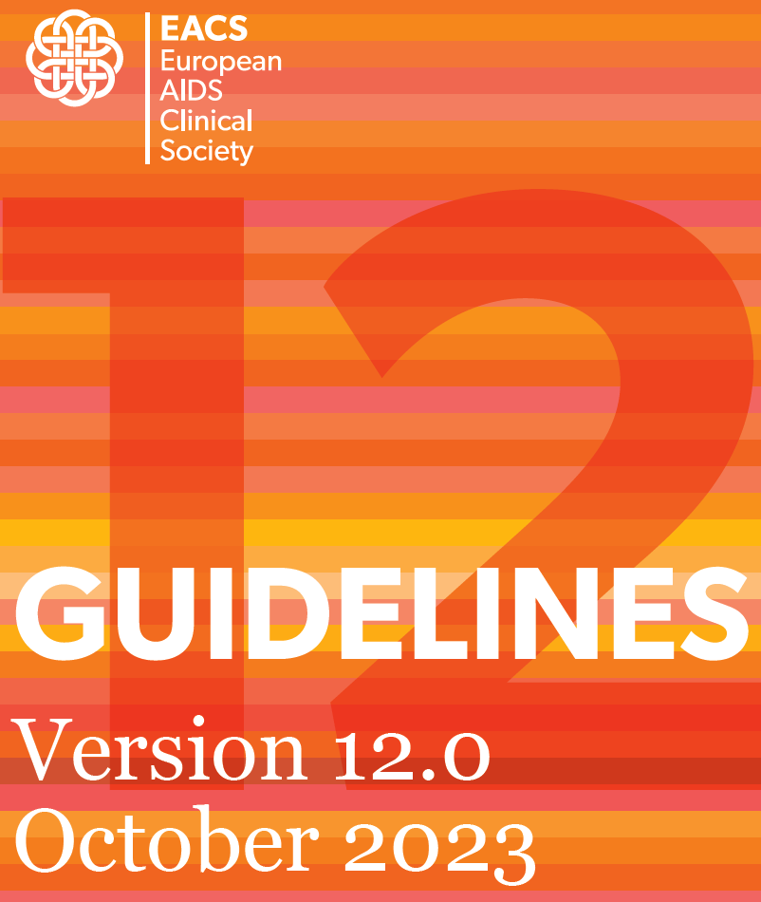

Slide 20
Treatment Goals for LDL-c to Reduce Cardiovascular Risk Depending on CV Risk Estimation
Treatment goal for LDL-c
3,0 mmol/l (116 mg/dl)
Low
2.6 mmol/l (100 mg/dl)
Moderate
1.8 mmol/l (70 mg/dl)
High
& > 50 % reduction from baseline
1.4 mmol/l (55 mg/dl)
Very high
Low
Moderate
High
High risk
CVD risk
CV risk estimation | < 50 y | 50-69 y | > 70 y
Low/moderate | <2.5% | <5% | <7.5%
High | 2.5 - <7.5% | 5 - <10% | 7.5-<15%
Very high | >7.5% | >10 % | >15%
SCORE2 and SCORE2-OP cardiovascular disease risk estimation stratified by age

Slide 21
REPRIEVE: pitavastatin in people living with HIV (1)
Background: statins lower LDL cholesterol, and have other beneficial effects on cardiovascular disease (anti-inflammation, anti-thrombotic, immunomodulator, reduced oxydative stress, improved endothelial function/vascular tone, plaque stabilization)
Pitavastatin is a moderate intensity statin with good LDL and anti-inflammatory properties
REPRIEVE study
Inclusion criteria
documented HIV, on stable ART, CD4 > 100/mm³, age 40-75 y, no known atherosclerotic cardiovascular disease
10-year atherosclerotic cardiovascular disease risk score
< 7.5% and LDL < 190 mg/dL
7.5%-10% and LDL < 160 mg/dL
> 10% and LDL < 130 mg/dL
7 769 patients randomized 1:1 to pitavastatin 4 mg once daily or placebo
Clinical primary endpoint: Major Cardiovascular Events (CV death, MI, unstable angina, transient ischemic attack or stroke, arterial revascularization, peripheral arterial disease)
Grinspoon S et al. 12th IAS 2023 ; abstr. SY0601, NEJM July 23, 2023

Slide 22
REPRIEVE: pitavastatin in people living with HIV (2)
After a median time of follow-up of 5.1 years, DSMB recommended early closure of the trial for efficacy
First Major Cardiovascular Event
First Major Cardiovascular Event or Death
0.10
Pitavastatin
0.10
Pitavastatin
0.08
Placebo
0.08
Placebo
0.06
0.06
-21 % vs placebo
0.04
-35 % vs placebo
0.04
0.02
0.02
0
0
Cumulative incidence of event
Cumulative incidence of event
0%
0%
0.6%
0.7%
1.0%
1.4%
1.4%
2.1%
1.9%
2.7%
2.4%
3.4%
2.7%
4.4%
0%
0%
0.8%
0.8%
1.6%
2.0%
2.4%
3.3%
3.4%
4.4%
4.5%
5.3%
5.5%
7.1%
0
12
24
36
48
60
72
0
12
24
36
48
60
72
Number at risk
Months
Number at risk
Months
3888
3881
3647
3693
3475
3506
3364
3356
2997
2997
1947
2182
1052
959
3888
3881
3647
3693
3475
3506
3364
3356
2998
2997
1948
1975
1027
919
Grinspoon S et al. 12th IAS 2023 ; abstr. SY0601, NEJM July 23, 2023

Slide 23
REPRIEVE: pitavastatin in people living with HIV (3)
Stratified (by sex and screening CD4 cell count) proportional hazards models
Pitavastatin IR/1000 PY (#events)
Placebo IR/1000 PY (#events)
Nominal p-value
N
N
HR (95% CI)
First Major Cradiovascular Event
Stratified Cox proportional hazard model (A)
3888
4.8 (89)
3881
7.3 (136)
0.65 (0.48-0.90)
0.002
Adjusted for ASCVD risk score (B)
3888
4.8 (89)
3881
7.3 (136)
0.66 (0.48-0.90)
0.002
Adjusted for multiple factors (C)
3885
4.8 (89)
3874
7.3 (136)
0.66 (0.48-0.91)
0.003
First Major Cradiovascular Event or Death
Stratified Cox proportional hazard model (A)
3888
9.2 (170)
3881
11.6 (216)
0.79 (0.65-0.96)
-
Adjusted for ASCVD risk score (B)
3888
9.2 (170)
3881
11.6 (216)
0.79 (0.64-0.96)
-
Adjusted for multiple factors (C)
3888
9.2 (170)
3874
11.7 (216)
0.80 (0.65-0.98)
-
0.5
0.7
1
2
Hazard ratio (95% CI)
A: treatment group as the only covariate
B: adjustment on atherosclerotic CV disease (ASCVD) risk score
C: adjustment on ASCVD risk score, age, race, smoking, hypertension, screening LDL, nadir CD4, total ART duration and region
Grinspoon S et al. 12th IAS 2023 ; abstr. SY0601, NEJM July 23, 2023

Slide 24
REPRIEVE: pitavastatin in people living with HIV (4)
Estimated incidence of Major CV event/1000 PY (95% CI)
in the placebo group
Risk score
0 - < 2.5
2.5 - < 5
5 - < 10
> 10
25
15
Line of Y = X
10
5
1
0
2,5
5.0
7.5
10.0
12.5
15.0
Enrollment ASCVD risk score (%) Median (P10-P90)
HIV increases CVD risk by ≠ 63 %
Grinspoon S et al. 12th IAS 2023 ; abstr. SY0601, NEJM July 23, 2023

Slide 25
REPRIEVE: pitavastatin in people living with HIV (5)
LDL reduction
30% in pitavastatin group vs no change in placebo ; durable effect over time
Clinical effect (35% reduction in events) higher than anticipated (17%) based on lowering of LDL
Adverse events
Serious adverse events similar in each group
Muscle-related symptoms higher in pitavastatin group but mostly mild (only 1% of withdrawal)
Diabetes rates: 5.3% in pitavastatin group vs 4.0% in placebo group
No effect on grade 3 ALT or rhabdomyolysis
Conclusion: statin therapy prevents major cardiovascular events in patients with HIV with low to moderate CV risk and normal range LDL-cholesterol
Grinspoon S et al. 12th IAS 2023 ; abstr. SY0601, NEJM July 23, 2023

Slide 26
REPRIEVE: NNT and implementation of results
5-year number needed to treat (95% CI)
Existing Treatment Thresholds (NNT ≤ 60)
Implementation of REPRIEVE Results ?
N
AHA/ACC Guidelines 2016 | ASCVD Risk | NNT 5 years | USPSTF 2022
Treat | 10-20% | 40-60 | Treat
Consider | 7.5-10% | 60-80 | Consider
Consider | 5-7.5% | 80-120 | Don’t consider
Don’t consider | < 5% | > 129
Overall
7769
106
By ASCVD risk score
REPRIEVE with ASCV score > 5%
( < 50% participants)
0 - < 2.5
2156
199
2.5 - < 5
2055
149
5 - < 10
2995
53
REPRIEVE overall results
> 10
563
35
REPRIEVE with ASCV score < 5%
( > 50% participants)
0
50
100
150
200
250
300
600

Slide 27
ASCVD Risk Score May Underestimate CVD Risk to a Greater Extent in Women with HIV
IR/1000PY
(# events)
Placebo
0 - >2.5
2.5 - <5
5 - 10
> 10
Males
3.66 (7)
3.67 (14)
10.83 (62)
16.72 (17)
Females
2.79 (10)
5.35 (7)
14.96 (16)
23.35 (3)
0
2.5
5
7.5
10
15
20
25
70
Incidence rate / 1000 PY (95% CI)
HIV may attenuate the "female advantage" in CVD risk
Results raise the question whether more women than men should be newly eligible for statins because of REPRIEVE
Consider statin in women with low ASCVD (2.5-5%) ?
Zanni, IAS, 2023

Slide 28
HIV and low ASCVD risk: benefit from statin ?
Using ACC/AHA guidelines, 2/3 of patients with HIV not recommended to be on statin had significant carotid plaque
Among HIV patients with ASCVD risk < 2.5%
30% had plaque on CT angiography
35% had CAC score > 0
Should coronary angioscan be considered in patients with HIV > 40 years
with intermediate ASCV risk ?
Even with low risk ?
REPRIEVE results will likely increase statin use in HIV patients 40-75 years and those with ASCD ≥ 5%
Phan BA. Circ CV Imaging 2017; Hoffmann U. JAMA Network Open 2021; Hsue P. IDWeek 2023

Slide 29
Which statin ?
Atorvastatin, Pitavastatin and Rosuvastatin have potent pleiotropic effects
Platelets: decreased activation and aggregation
Endothelial cells: increased nitric oxyde synthase expression/activity, decreased reactive oxygen species, increased endothelial progenity cell activity/production
Vascular smooth cells: decreased proliferation and migration, increased apoptosis
Macrophages/monocytes: decreased proliferation, major histocompatibility complex expression, and oxidized LDL uptake
Vascular inflammation: decreased MHC-II expression and hsCRP concentrations
Statin dosage
High-Intensity statin | Moderate-intensity statin
Diminution LDLc ≥ 50% | Diminution LDLc 30-50%
Atorvastatin 40-80 mg Rosuvastatin 20-40 mg | Atorvastatin 10-20 mg Pitavastatin 2-4 mg Rosuvastatin 5-10 mg

Slide 30
Evolocumab = fully human mAb that inhibits proprotein convertase subtilisin-kexin type 9 (PCSK9)
Multinational, placebo-controlled, double-blind, randomized phase 3 trial
Monthly sc evolocumab 420 mg 24 weeks of double-blind period + 28 weeks of open-label period
467 PWH with elevated LDL-C or nonhigh-density lipoprotein cholesterol (non-HDL-C), on stable maximally tolerated statin and stable ART
Efficacy assessment: percentage change from baseline in LDL–C, triglycerides, and atherogenic lipoproteins
Boccara F. AIDS 2022, 36 (5):675-82

Slide 31
BEIJERINCK study: W52 results
Evolocumab in Double blind period /evolocumab in Open Label Period
Placebo in Double blind period/evolocumab in Open Label Period
LDL-c
Non-HDL-c
10
10
0
0
-10
-10
-20
Mean percent change from baseline (SE)
Mean percent change from baseline (SE)
-30
-20
-40
-53,7%
-30
-46,7%
-50
-40
TGs
Lp(a)
-60
-59,9%
-50
-51,7%
20
20
-70
-60
W0
W12
W24
W36
W52
W0
W12
W24
W36
W52
10
10
Mean percent change from baseline (SE)
Mean percent change from baseline (SE)
0
0
-10
-9,6%
-10
-13,1%
10
Total cholesterol
10
ApoB
-134%
-20
-13,5%
0
0
-20
Mean percent change from baseline (SE)
-10
W0
W12
W24
W36
W52
W0
W12
W24
W36
W52
-10
Mean percent change from baseline (SE)
-20
-20
-30
-43,5%
-30
-40
-40
-50
-48,9%
-60
ApoA1
Remanant cholesterol
W0
W12
W24
W36
W52
W0
W12
W24
W36
W52
12
20
10
9,0%
10
8
0
Mean percent change from baseline (SE)
Mean percent change from baseline (SE)
TGs
VLDL-c
6
8,5%
-10
14
11,6%
20
4
-16,7%
12
10
2
-20
-21,0%
10
0
-30
Mean percent change from baseline (SE)
Mean percent change from baseline (SE)
8
10,1%
0
W0
W12
W24
W36
W52
W0
W12
W24
W36
W52
6
4
-10
-11,3%
2
-13,9%
0
-20
W0
W12
W24
W36
W52
W0
W12
W24
W36
W52
Boccara F. AIDS 2022, 36 (5):675-82

Slide 32
What about the Risk of hypertension with INSTI and TAF in Naïves?
Post-hoc analysis of NAMSAL and ADVANCE trials
NAMSAL
ART-naïve (N=613)
TDF/3TC + DTG vs TDF/3TC/EFV
BP measured at each visit (hypertension not routinely treated)
median BMI at baseline 23 kg/m²
ADVANCE
ART-naïve (N=1053)
TAF/FTC + DTG vs TDF/FTC + DTG vs TDF/FTC/EFV
BP measured at each visit (treatment if SBP/DBP > 140/90 mm Hg)
median BMI at baseline 24.1 kg/m²
Venter F et al. 12th IAS 2023 ; OALBB0504

Slide 33
Risk of hypertension with DTG and TAF in Naïves
NAMSAL
ADVANCE
Mean systolic BP change over time
p=ns
p=ns
p=0.02
p=0.02
p=0.01
p<0.01
Mean systolic BP change over time
12
TDF/3TC/DTG
6
TAF/FTC/DTG
TDF/FTC/DTG
TDF/FTC/EFV
10
TDF/3TC/EFV
5
8
Difference = 6.5 mmHg
4
6
3
2
4
1
2
0
0
-1
4
12
24
36
48
60
72
84
96
168
192
-1
-2
0
4
12
24
36
48
60
72
84
96
120
144
168
192
Week
Week
N=
1052
987
948
887
867
860
834
590
593
N=
613
588
575
564
572
556
542
544
538
529
499
488
481
%
SBP>140 or DBP>90
SBP>130 or DBP>85
40
p=ns
p=ns
p=0.001
p=0.002
%
p=ns
p=ns
p=ns
p=0.047
TDF/3TC/DTG
31
60
54
54
TDF/FTC/DTG TAF/FTC/DTG
30
TDF/3TC/EFV
25
50
43
46
45
39
40
41
40
38
37
TDF/FTC/EFV
20
17
19
12
12
14
12
30
10
10
11
20
10
Initial analysis suggests BP increase
mediated by weight gain, not drug
Role of ageing ?
0
Baseline
48
96
144
192
0
Week
Baseline
48
96
144
192
Week
N=
613
572
538
499
481
N=
1052
906
835
372
593
Venter F et al. 12th IAS 2023 ; OALBB0504

Slide 34
DTG: increased risk of hypertension ?
Adjusted mean (SE) change from baseline in BP, mm Hg
Data from 4 RCT in Naïves: SPRING-1, SPRING-2, SINGLE and FLAMINGO, with no baseline hypertension
DTG + 2 NRTI = 927
Comparator cART = 888
Blood pressure measured at baseline, W48 and W96
Incident hypertension (single SBD and/or DBP ≥ 140/90 mm Hg, antihypertensive use, HTN adverse event)
DTG = 23% (initiation of antihypertensive medication < 1%)
cART = 21% (initiation of antihypertensive medication < 1%)
5.0
DTG regimen (N=1223)
cART (N=1122)
SBP
DBP
4.0
2.62 (0.44)
2.01 (0.37)
2.42 (0.40)
1.80 (0.63)
3.0
1.57 (0.61)
1.62 (0.62)
1.56 (0.39)
1.25 (0.62)
2.0
1.0
0
Week 48
Week 96
Week 48
Week 96
Conclusion
Incident hypertension at W96 was not different between DTG and cART
Blood pressure increases were small and did not clinically or significantly differ between DTG and cART at W96
Pooled n
820
731
763
661
812
729
756
660
Significant predictors of increased BP: age, female sex,
higher baseline VL, higher baseline BMI
Patel P et al. 12th IAS 2023 ; LBEPB12

Slide 35
Impact of INSTI- and TAF-Related BMI Changes on Risk of Hypertension
Fully Adjusted Incidence Rate Ratios
RESPOND Cohort: Data from 13/19 observational HIV cohorts
PWH without hypertension (n=9704)
ART duration: 10 years
Developed hypertension
31% over 39,993 person-years of follow-up
Current use of INSTI was associated with incident hypertension
Adjustment for time-updated BMI attenuated the association with hypertension but remained significant
 | IRR (95% CI)
Hypertension INSTI with TAF INSTI, no TAF No INSTI with TAF | 1.48 (1.31, 1.68) 1.25 (1.13,1.39) 1.33 (1.14, 1.55)
Did they use the right analyses?
Byonanebye DM, et al. IAS 2023. Abstract OALBB0505.

Slide 36
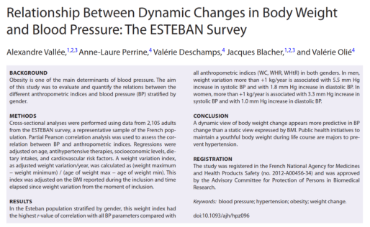
A dynamic view of body weight change appears more predictive in BP change than a static view expressed by BMI
Higher correlation between weight variation/year and BP increase compared with other anthropometric indices
Men
Women
79,0
77,9
78,6
77,7
78,2
77,5
Adjusted diastolic blood pressure
77,3
77,8
Adjusted diastolic blood pressure
77,4
77,1
77,0
76,9
76,7
76,6
76,5
76,2
76,3
-0,2 to 0 kg/year
0 to +0,2kg/year
0,8 to +1kg/year
-0,2 to 0 kg/year
0 to +0,2kg/year
0,8 to +1kg/year
More than -0,4kg/year
0,2 to +0,4kg/year
0,4 to +0,6kg/year
0,6 to +0,8kg/year
More than 1kg/year
More than -0,4kg/year
0,2 to +0,4kg/year
0,4 to +0,6kg/year
0,6 to +0,8kg/year
More than 1kg/year
Weight variation kg/year
Weight variation kg/year
BMI cannot differentiate between individuals with excess fat and those with a high muscle mass, and cannot discriminate the location of fat

Slide 37
Differentiating normal weight gain, return to health and ART-effect
How much weight gain is ''normal''?
Average US adult gains 0.5-1 kg/year^{1,2}
Germany: 0.23 [women] to 0.30 kg/year [men]³
from early- to middle-adulthood
➔ Remember many Pharma trials are based on US patient recruitment
ARV effects not mutually exclusive
Some ARVs cause excess weight gain : INSTls, TAF
Some ARVs suppress ''normal'' weight gain : TDF, EFV (plus ABC, rtv, cobi)
Return to health after starting effective treatment
Turn off organism (HIV) replication which was suppressing appetite
Return to health is through appetite
1. Haftenberger M, et al. Eur J Clin Nut 2016;70:300-5; 2. Zheng Y, et al. JAMA 2017;318:255-72; 3. Ma/hotra R, et al. Obesity 2013;21:1923-34;
4 . AIOSMAP. Weight gain and HIV treatment 2020. Available from: https://www.aidsmap.com/about-hiv/weight-gain-and-hiv-treatment. Accessed jan2022

Slide 38
ADVANCE: Weight change from baseline First-line TAF-LD, TLD, TLE, South Africa (1,053 HIV ART-Naïve)
Difference in weight gain in the regimens
2. Women gain more weight than men
3. Weight gain continued to rise at 144 Weeks
Women
Men
14
TAF/FTC + DTG
14
TAF/FTC + DTG
12
TDF/FTC + DTG
12
TDF/FTC + DTG
TDF/FTC/EFV
TDF/FTC/EFV
10
10
8
8
6
6
4
4
2
2
0
0
623
587
561
546
530
517
511
504
499
200
327
324
430
403
387
376
374
369
357
355
350
164
249
251
0
48
96
144
192
0
24
48
72
96
120
144
168
192
Weeks
Weeks
A Hill, M Mirchandani, B Simmons, S Sokhela, F Venter. Long-term risks of clinical obesity in the ADVANCE, NAMSAL and VISEND trials. HIV Glasgow, 2022. https://hivglasgow.org/wp-content/uploads/2023/01/P149_Hill_Andrew.pdf

Slide 39
How much of weight gain was a return to health (Societal Norm)?
Initial ART: Dolutegravir, TAF/TDF and efavirenz (ADVANCE) ADVANCE – Week 144 vs *
South African general population
Men
Women
35
30.1
29.1
29.2
30
25
20
15
27.6
28.4
BMI (kg/m²)
24.2
23.9
24.7
25.6
21.7
22.5
23.5
Baseline
EFV-F-TDF
DTG-F-TDF
DTG-F-TAF
SA NHANES
SA WHO 2016
Baseline
EFV-F-TDF
DTG-F-TDF
DTG-F-TAF
SA NHANES
SA WHO 2016
Higher EFV levels correlated with higher weight gain. Weight gain differences between EFV and DTG are driven by ETV toxicity impairing weight gain rather than by off-target effects of DTG causing weight gain
Sokhela et al, AIDS 2020; Mchiza et al, Int J Environ Res Public Health 2019
Silverberg et al, AIDS 2020; https://apps.who.int/gho/data/node.main.BMIMEANADULTC?lang=en

Slide 40
Salsa –switching to DTG 3TC Is TDF suppressing weight Gain?
GEMINI-1 and -2¹
from BL to Week 144
DTG/3TC
CAR
2,4 (1,2 ; 3,6)
3,0
2,4
2,3
0,2 (-1,2 ; 1,5)
DTG + 3TC: 3.7 kg
DTG + FTC/TDF: 2.4 kg
Hard to imagine the difference was due to 3TC vs FTC
1,6
Adjsuted mean change in weight from baseline (kg)
1,4
1,5
0,8
0,1
0
Baseline TAF use
Baseline TAF use
N =
Absolute mean weight at baseline, kg
83
78,3
91
81,0
108
74,7
106
76,8
Hypothesis : is TDF suppressing weight gain?
Hagins D, et al. Virtual CROI 2022; February 12-16, 2022. Abstr. 603

Slide 41
What about other newer drugs vs INSTIs? DOR/ISL vs BIC/FTC/TAF in Naïves
4,5
DOR/ISL (100/0,75 mg)
4,0
3,5
BIC/FTC/TAF
3,0
2,5
Mean change in weight from baseline (kg)
2,0
1,5
1,0
0,5
0
Baseline
W24
W48
Islatravir is a pipeline product and not approved so far.
Rockstroh JR et al. 12th IAS 2023 ; OALBX0101

Slide 42
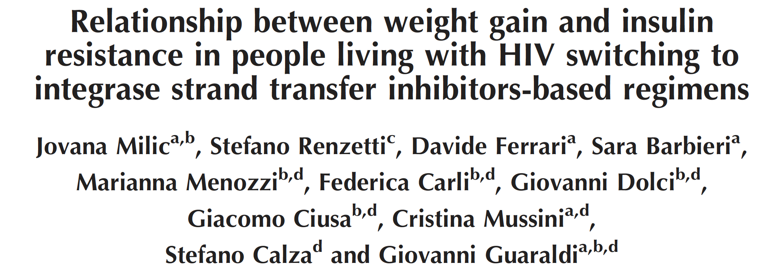
Longitudinal matched-cohort study including PWH attending Modena HIV Metabolic Clinic, Italy
Objectives:
Primary: explore weight and BMI changes in PWH switched to INSTI-based regimens (vs. non-INSTI)
Secondary objective: identify risk factors for insulin resistance and cut-off of weight or BMI increase associated with IR in PWH switching to INSTI
2437 PWH (1025 INSTI-switch, 1412 non-INSTI)
AIDS 2022, 36:1643–53

Slide 43
INSTI and/or TAF switch is associated with weight gain
(a)
non-INSTI
72
INSTI-switch
76
INSTI +TAF
+2kg
70
Weight (Kg)
INSTI + no TAF
72
Non INSTI + TAF
68
Weight (kg)
Non INSTI + no TAF
66
68
-10
-5
0
5
10
Time (years)
-10
0
10
Time (years)
Weight increase significantly higher in the 2 years post-INSTI switch (vs. non-INSTI), but no difference was observed in the late period after the switch
More weight gain if INSTI switch + TAF vs INSTI switch + no TAF (p = 0.028)
Milic J. AIDS 2022, 36:1643–53

Slide 44
INSTI switch is associated with lower IR
In the subset of PWH without IR, switching to INSTI (vs. non-INSTI) was associated with a lower risk of IR (HR 0.70, 95% CI: 0.51, 0.98)
non-INSTI
Weight gain
INSTI-switch
0.10
Switch INSTI
vs non INSTI
Insulin resistance
Probability of Insulin Resistance at 1 year
A weight increase by 1% over 1 year of follow-up reduced the total protective effect of INSTI by 21.1%, which identifies a 5% weight increase as a clinically meaningful weight gain definition (5.5% increase for BMI).
PWH in the INSTI-switch group with 5% weight gain and/or 5.5% BMI had the same probability of IR as an individual in the non-INSTI group without weight gain
Weight change = 5 %
0.05
-10
-5
0
5
10
% weight change

Slide 45
INSTI and risk of diabetes
Retrospective cohort, US
2008 to 2018
4 113 patients without diabetes
Time to diabetes incidence for each
year.
Multivariable Cox proportional hazard regression models
White Female vs White Male
Black Male vs White Male
Black Female vs White Male
Other Race/Sex vs White Male
Age 30-50 yrs vs Age < 30 yrs
Age >50 yrs vs Age < 30 yrs
BMI < 18.5 vs BMI 18.5-24.9
BMI 25-29.9 vs BMI 18.5-24.9
BMI 30-39 9 vs BMI 18.5-24 9
BMI > 40 vs BMI 18.5-24.9
Public vs Private Insurance
Unisured vs Private Insurance
CD4 < 200 vs CD4 > 350
CD4 200-350 vs CD4 > 350
HIV Viral Load > 400 vs HIV VL < 400
HIV Duration 5-10 yrs vs HIV < 5 yrs
HIV Duration >10 yrs vs HIV < 5 yrs
Heterosexual vs Homosexual
IVDU vs no IVDU
NRTI Exposure vs no NRTI Exposure
PI Exposure vs no PI Exposure
NNRTI Exposure vs no NNRTI Exposure
II Exposure vs no II Exposure
Steroid Exposure vs no Steroid Exposure
Statin Exposure vs no Statin Exposure
Other Lipid Lowering Drug Exposure vs No Exposure
Anti-Hypertensive Exposure vs No Exposure
Aspirin Exposure vs no Aspirin Exposure
Comorbid CKD/ESRD vs None
Comorbid Hypertension vs None
Comorbid Dyslipidemia vs None
Comorbid Cirrhosis/ESLD vs None
0.61 (0.24, 1.52)
1.19 (0.81, 1.76)
1.38 (0.80, 2.40)
0.62 (0.15, 2.61)
1.81 (0.71, 4.61)
2.50 (0.96, 6.51)
2.83 (1.17, 6.83)
1.96 (1.27, 3.03)
3.98 (2.60, 6.10)
10.51 (6.23, 17.72)
1.21(0.90, 1.63)
0.94 (0.53, 1.67)
1.62 (1.00, 2.63)
1.55 (1.07, 2.25)
0.85 (0.52, 1.38)
0.93 (0.55, 1.58)
1.62 (1.05, 2.49)
0.96 (0.64, 1.44)
0.96 (0.57, 1.61)
0.64 (0.38, 1.08)
0.92 (0.66, 1.28)
1.03 (0.74, 1.45)
1.48 (1.09, 1.99)
1.46 (1.10, 1.94)
0.97 (0.67, 1.36)
1.54 (1.06, 2.25)
1.43 (0.95, 2.16)
1.16 (0.79, 1.70)
1.32 (0.94, 1.86)
1.36 (0.88, 2.08)
1.60 (1.12, 2.27)
1.90 (1.17, 3.08)
Multivariable analysis of diabetes risk
BMI > 25 (++++ if > 40)
CD4 < 350/mm³
HIV > 10 ans
Hypolipidemic treatment
Dyslipidemia
Steroid exposure
Cirrhosis
… and INSTI exposure
0.3
0.5
1.0
3.0
5.0
10.0
Hazard Ratio (95% CI)
Spieler, AIDS 2022, 36:1811–1818

Slide 46
Impact of GLP-1 receptor agonists on body weight in patients with type 2 diabetes and HIV
Change in weight (kg) before and after initiation of a GLP-1 RA
Baseline weight (kg)
Follow-up weight (kg)
Hypothesis of the pathogenesis of lipodystrophy syndrome and proposed impact of GLP-1 receptor agonists
Weight (kg)
122
-10.4 (±12.47) kg
120
-1.73 (±8.45) kg
118
P = 0.0085
119.4
116
117.3
114
115.6
112
Lipogenesis 1 ↓
Cardiovascular Disease
110
108
109
ART for
PWH
106
Apoptosis of
adipocytes
Lipodystrophy
104
GLP-1 RA
102
Proinflarnmatory
cytokines ↑
DM only (n=30)
DM + HIV (n=15)
INSTI-based ART: 86.7%
% change in HbA1c: - 0.49%
% change in HbA1c: - 1.3%
P = 0.24
Lloyd AN et al. 12th IAS 2023 ; EPB0195

Slide 47
Effects of Semaglutide on Adipose Tissue in HIV-Associated Lipohypertrophy
Single-site, randomized (1:1), double-blind, placebo-controlled study
108 patients with HIV-1 RNA <400 c/mL for ≥ 6 months on stable ART, BMI ≥25 kg/m², waist circumference > 95 cm (men) or > 94 cm (women), waist:hip > 0.94 (men) or > 0.88 (women), with lipohypertrophy and subjective increased abdominal girth after ART initiation
Semaglutide QW
Placebo
Primary endpoint: visceral adipose tissue by CT
Secondary endpoints: weight; subcutaneous adipose tissue by CT; DXA-measured total, trunk and limb fat; lean body mass
p = 0,99
150
p < 0,01
↑0.2%
↓8.3%
100
Weight (kg)
0
0
32 weeks
0
32 weeks
Placebo
Semaglutide
McComsey. IDWeek 2023. Abstr 1984.

Slide 48
Effects of Semaglutide on Adipose Tissue in HIV-Associated Lipohypertrophy
Trunk fat (g)
Lean mass (g)
40 000
p = 0.84
100 000
p = 0.21
p = 0.015
p < 0.01
p < 0.01
30 000
↑0.4%
70 000
↓0.6%
↓17%
↓5.4%
40 000
20 000
10 000
10 000
0
0
32 weeks
0
32 weeks
0
32 weeks
0
32 weeks
Placebo
Semaglutide
Placebo
Semaglutide
Concerns :
no loss if liver or pericardial fat depots
Lean mass loss in a population known to lose lean mass over time: worsening of lipoatrophy
Need for CVD endpoints, immune activation and inflammation markers changes, etc.
McComsey. IDWeek 2023. Abstr 1984

Slide 49
Lifestyle?
Change in weight according to sex
2
0
Usual care, women
Interventions for overweight: Reduced intake and more exercise
-2
Usual care, men
-4
Percent change from baseline
Intensive-lifestyle intervention, women
-6
Intensive-lifestyle intervention, men
Reduce energy intake (WHO)
Increase physical activity (WHO)
more public exercise space
Specific diets (121 RCTs, n=21,942)
-8
-10
0
6
12
18
24
Months
Change in weight according to age group
2
Usual care, 21-42 yr
0
Usual care, 43-56 yr
-2
Usual care, 57-74 yr
Intensive-lifestyle intervention, 21-42 yr
-4
Percent change from baseline
-6
Intensive-lifestyle intervention, 43-56 yr
Intensive-lifestyle intervention, 57-74 yr
-8
-10
0
6
12
18
24
Months
Ge et al, BMJ 2020; Katzmarzyk et al, N Engl J Med 2020

Slide 50
INSTIs and Metabolic changes and CVD
Conclusions:
Data differs and needs to be adjusted for weight gain
Randomised trials of initial ART with INSTI/TAF vs. non- INSTI/non-TAF (e.g. ISL-DOR) may be informative
Traditional interventions to prevent and treat established CVD likely to be more beneficial than INSTI/TAF switching (but doing both might be additive)
REPRIEVE may have major consequences for HIV patients and providers

Slide 51
COMING UP : CROI 2024 WEBINAR
Faculty
Pedro Cahn, Buenos-Aires, Argentina
Anton Pozniak, London, UK
François Raffi, Nantes, France

